Slide 1
Graphical Abstract Instructions (1/4)
Please use this file and its elements to help build the graphical representation of your study.
Use slide 6 of this slide deck to build your graphical abstract.
Summarize your main findings as outlined on the following slide.
You may include images or photos, if they enhance presentation of the main message.
You may also use the elements provided separately (see slide 9).
You may not use any copyright material.
If you have any questions, please contact ejps@thieme.com.

Slide 2
Graphical Abstract Instructions (2/4)
The graphical abstract should highlight the main findings of the study.
It should be easy to read and understand, the goal is for the reader to instantly grasp
  a) what the study is about,
  b) what was done,
  c) what was found,
  d) if appropriate, what it means.
It needs to include a graph or figure (less preferred a table).

Slide 3
Graphical Abstract Instructions (3/4)
Dos
Use a short title.
Minimize text, you may use bullet points.
Precision:
  for <10, use one decimal point (e.g., 5.3%)
  for >10, use full numbers (e.g., 65%)
Don’ts
No need to use the same title as the paper.
Avoid full sentences.
Sub headers (e.g., Background, Methods, Results) are not needed.

Slide 4
Graphical Abstract Instructions (4/4)
Methods
Include type and n of patients, intervention and comparison. If any of these aspects are clear from the results or summary statement, do not include in the methods.
It is strongly recommended to include an endoscopic image.
Summary Statement
If not apparent from the results, state main findings/conclusion.
Results
Show the most important outcome/finding of the study.
Use a figure (preferred) or table.
Needs to be self-explanatory.
Make it easy to read (the idea is that the reader understand the results within seconds).
Include only the essential.

Slide 5
Please use slide 6 for your infographic, with the fonts, colors, and arrows shown below:
Title (short title of your manuscript must be included)
Text (Thieme Argo 2011 Black 12 pt)
Legend in graph (Thieme Argo 2011 Light 10 pt)
Please use these colors
(Theme Colors in Drawing Tools menu)
Please use this arrow (you may change size or colour)
 | Text
 | Text
 | Text
 | Text
 | Text
 | Text
Notes:
-the slide needs to be written in the text font that we want them to use
-you need to chose which colors we want them to use…do not include ppt instructions
-you need to chose which arrows we want them to use
The language should be set as English
All icons can be provided on the following slides

Slide 6
[Enter title here]
Please use this slide for your Infographic
ONLY use the fonts and colors shown on the previous slide
Check the following slides for a suggestion on how to structure your graphical abstract in case of a RCT.
this box can be deleted after reading

Slide 7
[Title]
Background + Method
(only what‘s essential)
Image(s)
Key results as a figure
Consider the following components:
What is unknown/the problem?
N patients
Intervention
Comparison
[include summary statement]
[use this format for a graphical abstract of a randomized trial]

Slide 8
Graphical Abstract Icons
In case you would like to use icons in your graphical abstract please use the ones provided under the following link: https://www.thieme.de/de/european-journal-pediatric-surgery/authors-9863.htm
Please use icons sparingly and ensure that they enhance the message of your graphical abstract and support instant grasping of what is shown.

Slide 9








































Body and Organs
Copy from this slide

Slide 10








































Body and Organs
Copy from this slide

Slide 11






















Tools and Equipment
Copy from this slide

Slide 12






















Tools and Equipment
Copy from this slide

Slide 13
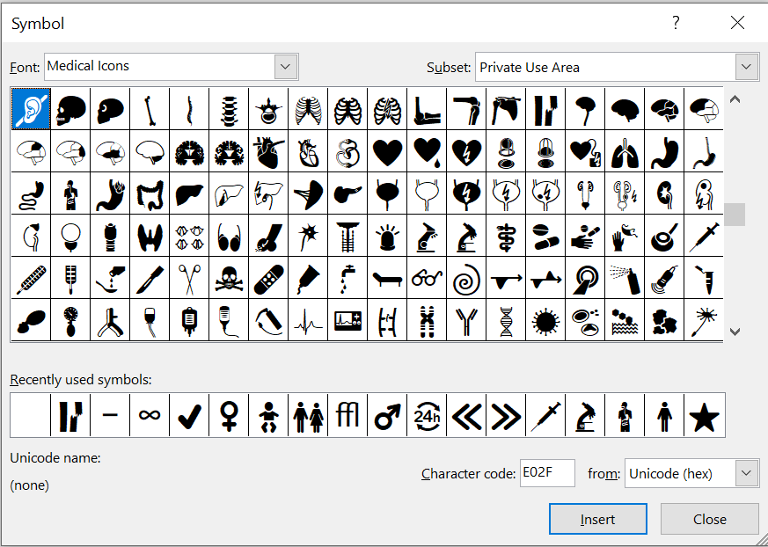
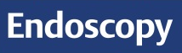
Medical Icons Font
The font "Medical Icons" offers a large number of medical icons.
If the font does not display, you can download it here.

